Slide 1
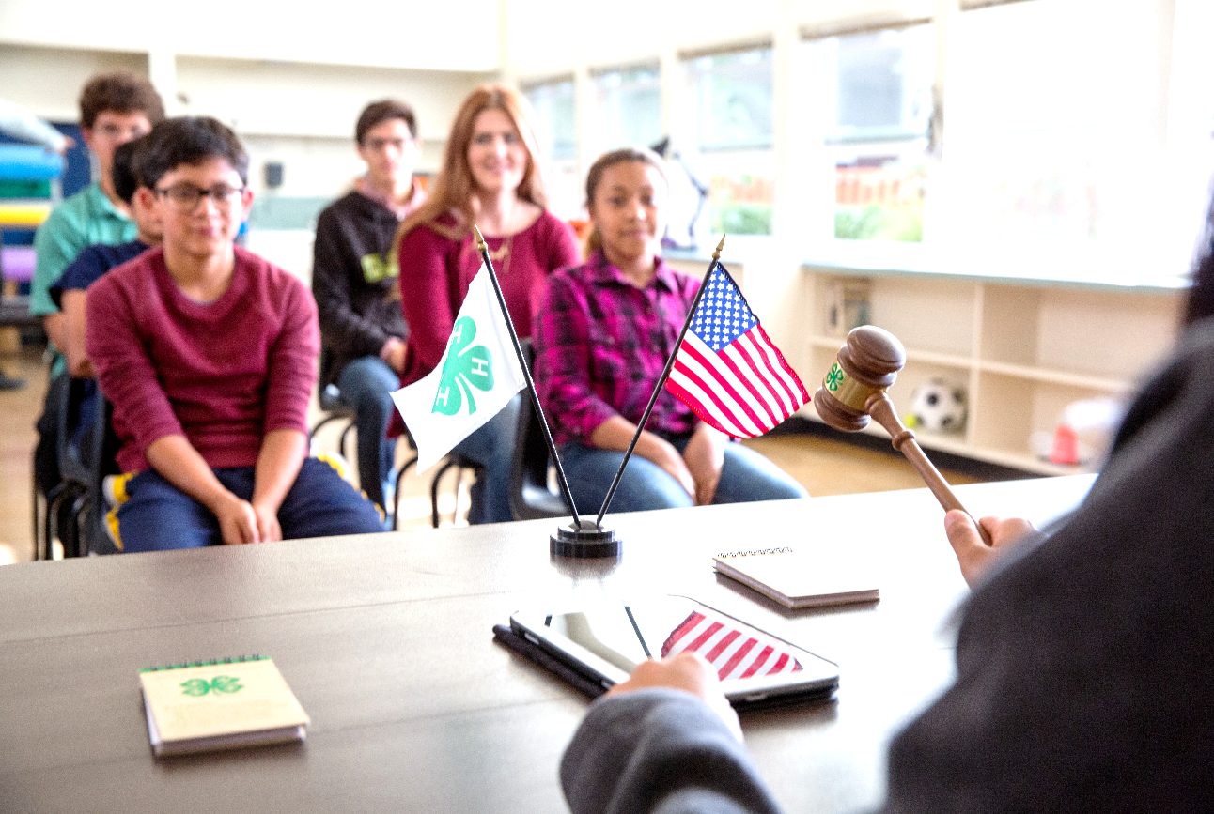

4-H EVENTS Council
Webinar I
Notes:
Introductions
Welcome
Reminder of recording

Slide 2

Objectives of Webinar 1
Understand the Basics of 4-H Events Council:
  Purpose of 4-H Council: For Youth and Programming Efforts
  Roles and responsibilities
  By-laws: Membership, Voting Rights, Committees
  Agents' role
Notes:
Amy

Slide 3
Objectives of Webinar 2
Understand 4-H Council Finances
Learn ways to make 4-H Events Council more effective
Learn new ways for engaging council members as they represent their club and help advance 4-H youth development program outcomes through educational events
Respond to feedback and questions
Notes:
Amy

Slide 4
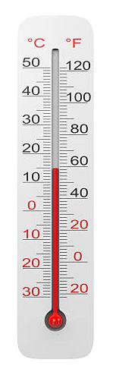
Taking the Temperature
Select a response to the effectiveness of your local Events Council
Going Great! Great discussion at each meeting and tasks move forward by members
Need Improvement! Representatives attend, but do not express opinions. The agent is expected to do all the work after the meeting.
HELP! Poor attendance, no one engages in discussion. Agent expected to do everything.
Somewhere in the middle

Slide 5
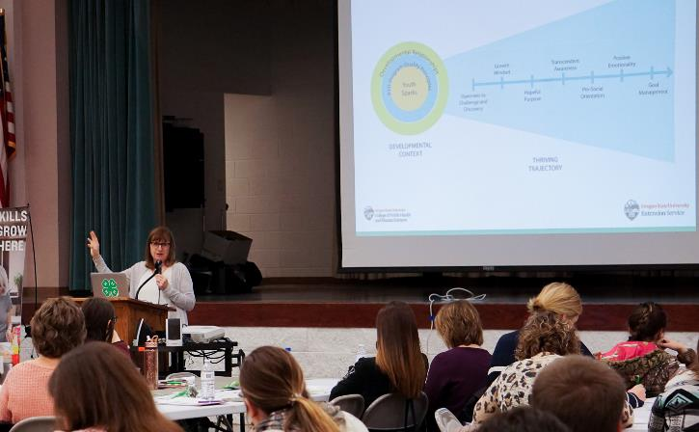
Purpose of a 4-H Events Council
“4-H provides many different types of programs to meet the needs of youth as they grow and develop. What happens in 4-H programs, how they are planned and led, makes a huge difference in the impact of the program on youth!”
Dr. Mary Arnold, professor and 4-H Youth Development Specialist at Oregon State University
Notes:
Diane
If you attended Program Rally last month, you heard Dr. Mary Arnold, speak on the 4-H Thriving Model. We'll start with a quote from her as we think about the overall purpose of the

Slide 6
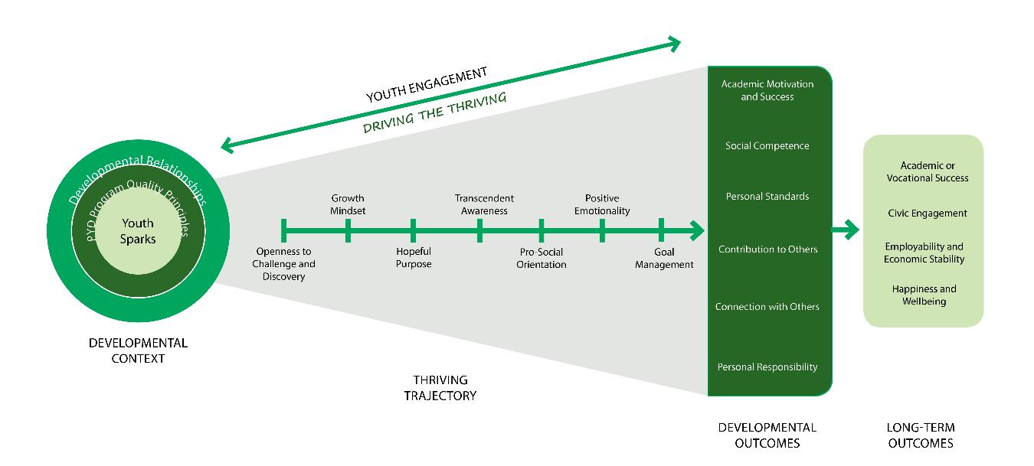
Purpose of a 4-H Events Council
4-H Thriving Model: Youth Program Quality Principles
Opportunities for skill building
Support for efficacy and mattering
Supportive Relationships
Notes:
Diane
Dr. Arnold says that in order to have the biggest impact, programs need to adhere to eight critical principles of program quality. From Eccles, J., & Gootman, J. (Eds). (2002). Community programs to promote youth development. Washington DC: National Academy Press.
I have highlighted 3
Opportunities for skill building: positive group setting to apply skills. Youth plan and conduct 4-H educational events that affect the local club program
Support for efficacy and mattering: creates ways for youth have a voice to represent their club, they are respected for their ideas and contributions
Supportive Relationships: creates an environment to practice team building as they work with other representatives from other clubs form the 4-H Events Council
We will include a link to the document outlining the 8 program quality principles

Slide 7
Purpose of a 4-H Events Council
To aid in the development of all local 4-H youth development educational programs that are approved by the local Extension Board by giving leadership to the planning and conducting of:
educational events,
volunteer leader training, and
teen leader training
Strengthen the overall 4-H Youth Development Program
Notes:
Diane

Slide 8
Position Description of Representative
General Responsibilities
Prepare for Council Meetings
Attend and Participate
Report back to 4-H Club
Serve on Council Committees
Notes:
Beth
1. Prepare for Council Meetings
- Know what is going on in their club.
- Represent interests of club members in decisions of the Council.
- Read the 4-H newsletter.
- Know what is coming up on the calendar.
2. Attend and Participate
- Arrive on time.
- Take notes.
- Express opinions of their club and vote as your club would.
- Ask questions when things are unclear.
- Listen and be open minded and fair in your actions.
3. Report back to 4-H Club
- Attend 4-H Club meetings.
- Before meetings, give a report to club officers to let them know of issues the clubs needs to consider.
- Report on the council meeting to their club; ask for opinions, decisions and actions as needed. Record those decisions, in preparation for the next meeting.
- Ask for items that need to brought up at council.
4. Serve on Council Committees
- Represent interests of club members in committee work of the Council.
- Help plan council events.
- Help conduct council events.
- Prepare items for the 4-H newsletter.

Slide 9
Position Description of a Representative
Contact People:
• 4-H Club Organization Leaders
• Officers of the 4-H Council
• County Extension Agent(s)
Resources Available:
General Responsibilities
5. Know Contact People
6. Commit to Time Required
7. Qualifications
Notes:
Beth
Know Contact People:
• 4-H Club Organization Leaders
• Officers of the 4-H Council
• Local Extension Agent(s)
Resources Available:
Commit to Time Required:
One-year term (some counties and some clubs elect their current and immediate past-president for a two-year term).
Council meeting frequency varies from county to county.
Committee work time varies.
Qualifications:
Member of a 4-H club, preferably with at least two years’ experience.
Willingness to take a leadership role in the Local Extension Unit 4-H Program.
Maturity and ability to communicate with adults and older club members from other 4-H Clubs.

Slide 10
Responsibility of a 4-H Events Council
Planning & Conducting 4-H educational events
* Educational events should align with Action Plans as developed by Agent & 4-H PDC
Raising & management of funds to support events (finance information will be covered in 2nd webinar)
Notes:
Amy
4-H Councils are responsible for planning and conducting 4-H activities that affect clubs and club members. These educational events should follow the plans of work as established by the 4-H PDC (Program Development Committee) and approved by the Extension Council Board.

Slide 11
Responsibility of a 4-H Council
Representing Others
Encourage club participation in activities
Know far enough in advance that council reps can take information back and forth. Especially for BIG Decisions, Fundraisers, Fair Changes
Notes:
Amy
4-H Council representatives represent members of their club. They need to KNOW the members they represent. Delegates represent the majority opinion of their members in the decisions and actions of the Council.

Slide 12
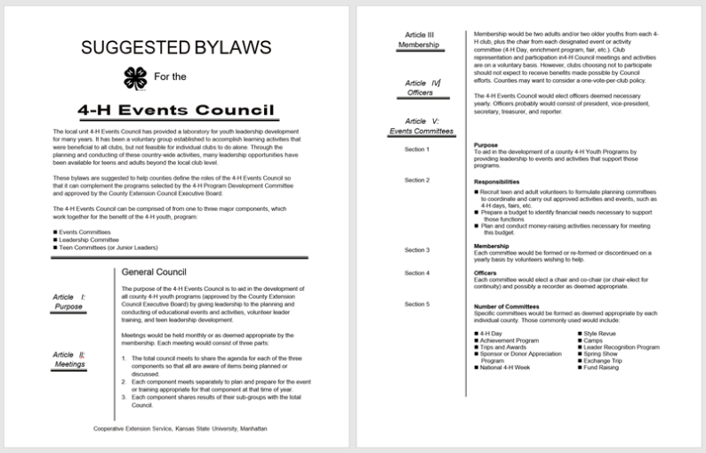
Suggested By-Laws
Constitution
By Laws
Notes:
Amy ask people share copies of the by laws

Slide 13
Suggested By Laws
Membership of 4-H Events Council: Two youth and two adults from each club
Voting rights options: One vote per club, one vote per representative, or only youth vote
Suggested committees: Should be formed based on local needs:
National 4-H Week, Officer Training, Achievement Celebration, 4-H Day, 484H, Exchange Trip, Budget & Finance, Fundraising – Food Stand
Notes:
Diane
Membership: Two youth (president and one elected) and two adults, or two youth and one adult; adults are club leaders; sending a alternate
Voting rights options: one vote per club, one vote per representative, only youth vote

Slide 14
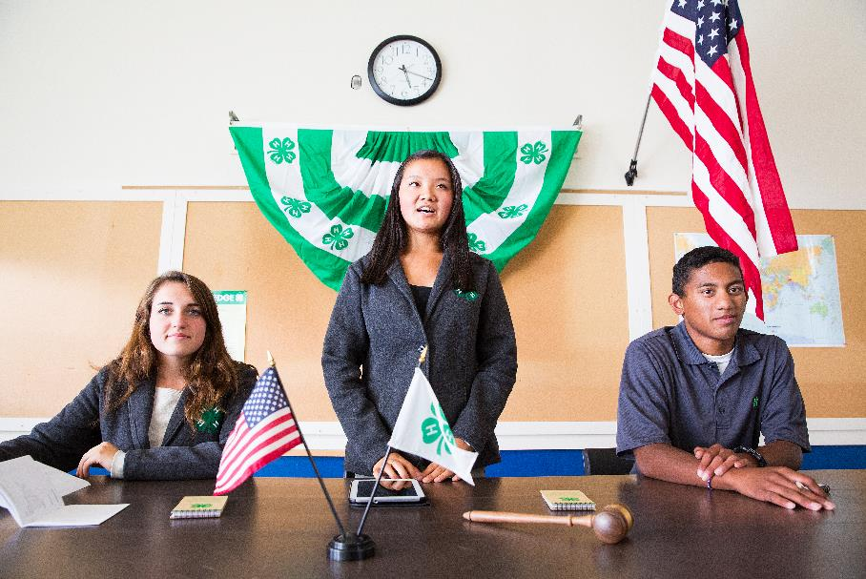
4-H Events Council Officers
Typical Officers/Leaders
President
Vice President
Secretary
Treasurer
Reporter
Adult Sponsor
Notes:
Beth
Officer/Leaders Responsibilities
President:
• Presides at all Council Meetings
• Appoints committees and committee chairs
• Leads the Officer Team in planning for each council meeting
• Asks for advice from the Extension Agent or sponsor in planning for each meeting
• Monitors the work of the committees
• Represents the interests of council
Vice President:
• Presides at Council meetings in the absence of the president
• Assisting the president when asked
• Helping plan council meetings
• Responsible for arranging programs for the council meetings
Secretary:
• Records minutes of Council meetings.
• Informs the president of unfinished business.
• Helps plan Council meetings.
• Maintains the roll and other records for the Council as directed by the president and by- laws.
Treasurer:
Because of the volume of transactions and number of unit wide funds this is often a partnership with staff in the local office to keep an accurate account of any money that may be the property of the 4-H Council, pay bills approved by the Council and prepare reports for each council meeting of the account.
Make a complete financial report presentation at each meeting
Helps plan Council meetings.
Reporter:
• Collects information about clubs, groups, and activities sponsored by the Council for use in news stories.
• Helps promote media coverage of 4-H events.
• Helps tell the 4-H story to various audiences.
• Helps plan Council meetings.
• When possible takes training with Ambassadors in communication skills.
Your 4-H Council may have an adult volunteer/sponsor position:
• Training. Advising officers and delegates in their duties.
• Coordination. Helping the Council avoid conflicts with 4-H and other community interests.
• Participating. Attend Council meetings as adviser to officers and delegates.
• Monitor. Check with officers and committees and Extension office staff on follow up work resulting from Council decisions.
Council Officer and Member Training and Orientation
Use some of these slides to training your representatives a the beginning of the year.

Slide 15
How often are Meetings?
Select a response that best represents how often your 4-H Events Council meets?
Monthly
Every Other Month
Quarterly
1-2 times per year
Notes:
Beth
You need to have enough meetings to cover the program in your unit.
Take the opportunity of youth being together to offer leadership training
Go back and look historically at minutes, past agendas, and look at the upcoming etc.
Meetings are the opportunity for youth engagement

Slide 16
Agents' Role
Know purposes and function of the 4-H Events Council.
Know responsibilities of 4-H program development committee and local unit Extension Executive Board.
Know the agent's job description as it relates to 4-H.
Support Council officers and chairs as they guide their membership through their work toward achieving their purposes.
Remind officers and chairs of possible agenda items.
Provide resources: educational materials, equipment, office administrative work, and listing of human and material resources available.
Notes:
Amy
Make to have a conversation among colleagues and adult volunteers about expectations of shared roles and responsibilities.
COACHING- support, guidance, encouragement, resources, etc.

Slide 17
Agents' is NOT:
Chair meetings
Act as recorder
Develop plans for Council approval
Accept other responsibility for activities properly belonging to the 4-H Events Council
Notes:
Amy
Know your councils. Some councils will need more assistance and coaching than others. In the perfect world, we strive for youth ownership- we want the young people to take the reigns.

Slide 18
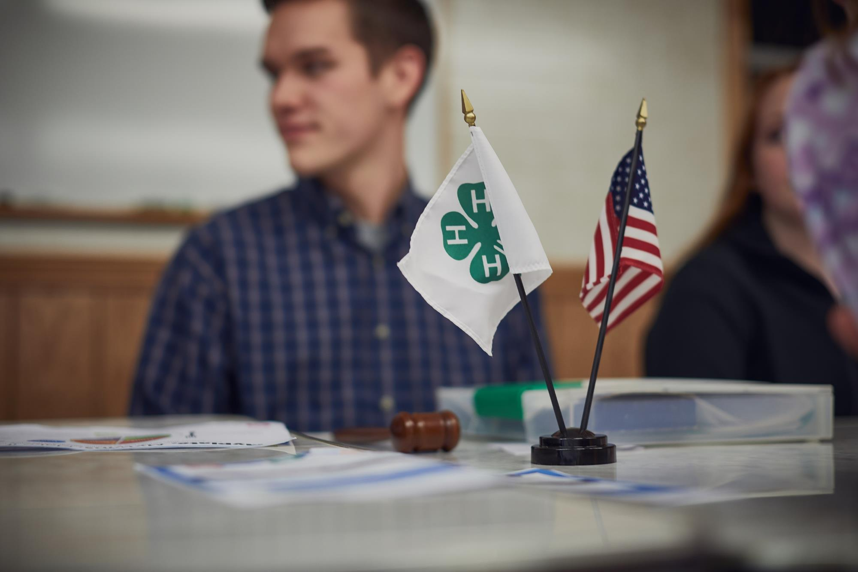
Thoughts, Ideas, Questions?
Notes:
Next webinar reminder

Slide 19
Thank You
Webinar II:
Wednesday, February 26, 2020
9:15-10:15 am
Resources will be uploaded and available here:
https://www.kansas4-h.org/resources/4-h-library/untitled.html

